Slide 1

Sales And Inventory Management System
CODE Technology
C O M P U T E R S O L U T I O N S
For Code Technology Kegalle
K. A. D. K. S. Perera - 1910282

Slide 2
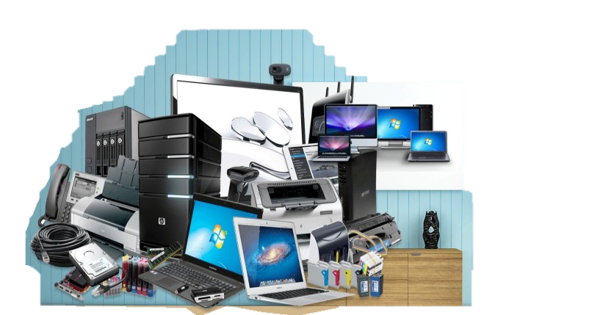
About the Client
Code Technology is one of the most
popular up coming computer
shop in Sri Lanka
which was started in 2017
It is located in Kegalle town.
They sell different types of computer accessories.

Slide 3

Motivation
Code Technology Computer shop currently uses a manual,
paper-based system to manage sales,
manage employees, manage customers, manage item
,manage purchases, manage suppliers and
manage all kind of business tasks.
They have to manage all those things manually and if errors occurred have to go through all logbooks to track those errors.
Therefore, this existing paper-based system has lots of limitations and drawbacks.
This project intends to deliver an easily manageable software solution to increase the manageability and productivity of the company.

Slide 4


Objectives
Deliver an easily manageable software solution to increase the manageability and productivity for a device and platform that is most suitable for every system user.
To minimize the time and effort of the client in finding all data about customer , supplier , items, categories and employee management
To create a method to quickly see and manage the all purchases and all types of sales
To minimize the time and effort of the client in calculating total incomes and total expenses monthly.
To minimize the time and effort of the client in creating various types of reports.

Slide 5

Main Functions
Manage Employees
Manage Items
Manage Purchases
Generate Reports
Manage Sales
Manage Supplier
Manage stocked items.
Manage stores data
Store Keeper
Manage Sales
Manage Items
Owner (Admin)
Cashier

Slide 6









Technical Details
Platform
Database
Web Application
MySQL
Programming Languages
IDE
PHP
HTML
JavaScript
UI Framework - Bootstrap
Visual Studio Code
Web Server Solution
WAMPP

Slide 7

Thank You !
K. A. D. K. S. Perera
Index No - 1910282

